Slide 1
TED TALKS: Teen Tobacco & E-Cig Usage Trends
By: Kashifa AHMED, Charles CAMPISI, Carol PIETRO, & Ian VALENTIK

Slide 2
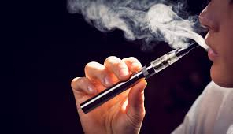
INSPIRATION
TED Talk
Substantial claims of an massive increase in teen usage of E-Cigarettes/Vaping
Notes:
After watching the video and seeing the resources listed with the statistical data from the video, this seemed a great starting point for developing a project topic and hypothesis.
Biobehavioral scientist, Suchrita Krishnan-Sarin explains, “E-cigarettes and vapes have exploded in popularity in the last decade, especially among youth and young adults -- from 2011 to 2015, e-cigarette use among high school students in the US increased by 900 percent.” She also explains “what you're actually inhaling when you vape (hint: it's definitely not water vapor)” and explores the disturbing marketing tactics being used to target kids. "Our health, the health of our children and our future generations is far too valuable to let it go up in smoke -- or even in aerosol," she says.
The reason this statistic is alarming is enforced in the next set of stats, from a 2012 US Surgeon General report noting that the percentage of DAILY Adult smokers that started before the age of 18 is 88%.

Slide 3
US Surgeon General: Calls Rise Epidemic
“In fact, we have known for a long time that 90 percent of smokers start smoking cigarettes prior to the age of 18. Those who start early are more addicted and have a harder time quitting smoking."
WE WONDERED:
Is there a significant change in teen e-cigarette usage?
TED Talk stated a 900% increase in E-cigarette usage since 2011
Are their differences in gender and ethnicity in the percentage of E-cigarette users?
Notes:
This report was updated in 2018 with the latest information available from various surveys all conducted by the CDC.
E-cigarettes entered the U.S. marketplace around 2007, and since 2014, they have been the most commonly used tobacco product among U.S. youth.² E-cigarette use among U.S. middle and high school students increased 900% during 2011-2015, before declining for the first time during 2015-2017.³ However, current e-cigarette use increased 78% among high school students during the past year, from 11.7% in 2017 to 20.8% in 2018.⁴ In 2018, more than 3.6 million U.S. youth, including 1 in 5 high school students and 1 in 20 middle school students, currently use e-cigarettes.⁴

Slide 4
CDC: Centers for Disease Control
Youth Risk Behavior Surveillance System (YRBSS) http://www.cdc.gov/yrbs
All public and private school students in grades 9–12 nationwide
Initiated in 1991
Administered Biennially
To provide data on health risk behaviors that contribute to leading causes of mortality, morbidity, and social problems among youth and adults in the United States
Cigarette, cigar, and smokeless tobacco use
Includes E-Cigarette usage as of 2015
Notes:
The Dataset we decided to use is the Youth Risk Behavior Surveillance System, which contained data from 1993 to 2017. The data included confidence stats in each row of data collected and was available through API as well as a download.
We had confidence in the CDC as a reliable and well documented source for our data. We did have questions concerning the survey and if we could find enough data to analyze for our hypothesis. We realized however, the data range mentioned in the TED talk was 2011 – 2017 which matched out data. So we jumped in to our project.

Slide 5
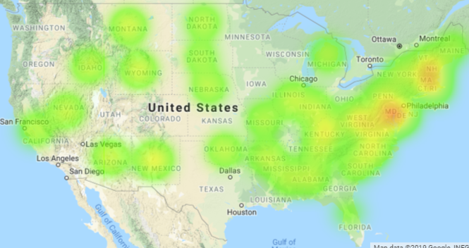
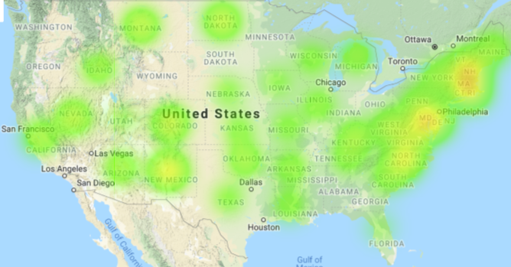
HEAT MAPS: 2015 vs. 2017 E-Cigarette Use
Lower 48 - 2015
Lower 48 - 2017
Notes:
One of the first graphics we created were heat maps, so we could visualize the distribution of the respondents across the US. The first steps in cleansing the data came when we had to define what area’s to represent. The survey included, US territories; Guam, Puerto Rico as Washington DC. We decided to remove the territories but kept DC.

Slide 6




HEAT MAPS: 2015 vs. 2017 E-Cigarette Use
Alaska & Hawaii
Alaska & Hawaii
Notes:
One of the first graphics we created were heat maps, so we could visualize the distribution of the respondents across the US. The first steps in cleansing the data came when we had to define what area’s to represent. The survey included, US territories; Guam, Puerto Rico as Washington DC. We decided to remove the territories but kept DC.

Slide 7
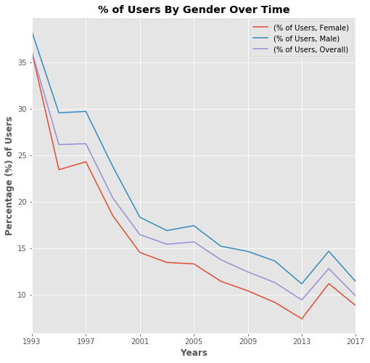
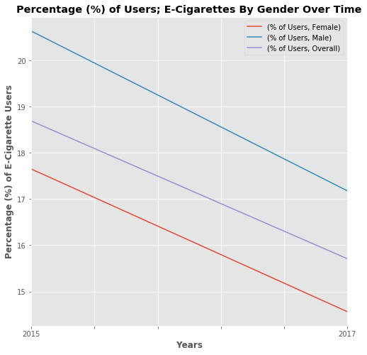
GENDER: Percentage of Users by Gender
Notes:
E-Cigarette trend seems to be following the same trend downward as the overall tobacco usage. This graph demonstrates the area of the US, broken down by gender, first all years and all usage types, then highlighting the years of 2015 through 2017 by E-cigarette users specifically.

Slide 8
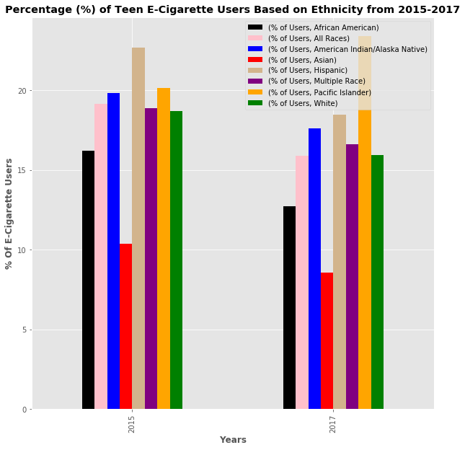
ETHNICITY: Does Race Change Usage?
Notes:
Another question we wondered about was if there were significant differences between races. Race being a value tracked by the survey. The graph compares e-cigarette users from years, 2015 and 2017 by the race values tracked and demonstrates overall downward trend in all the races values except for Pacific Islanders, which appears that usage goes up.

Slide 9
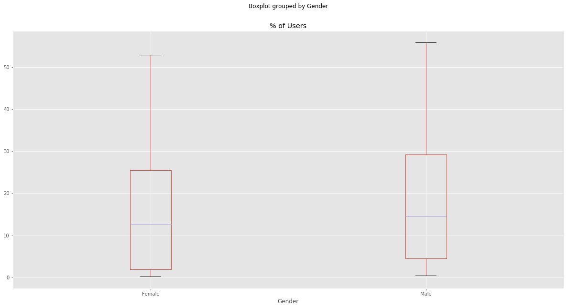
Boxplot for Comparing Means for E-Cig All Usage by Gender in USA
F_onewayResult(statistic=4.616410762730868, pvalue=0.032083628905618916)
Notes:
The box plot of the gender graphing shows a P value of 0.032, which determines that stats regarding gender have statistical significance and are not just chance. Originally we performed this test and included the overall gender, this proved to be problematic since both genders are a part of the whole. When the test was repeated without the whole, we found the results we needed to support our graphs.

Slide 10
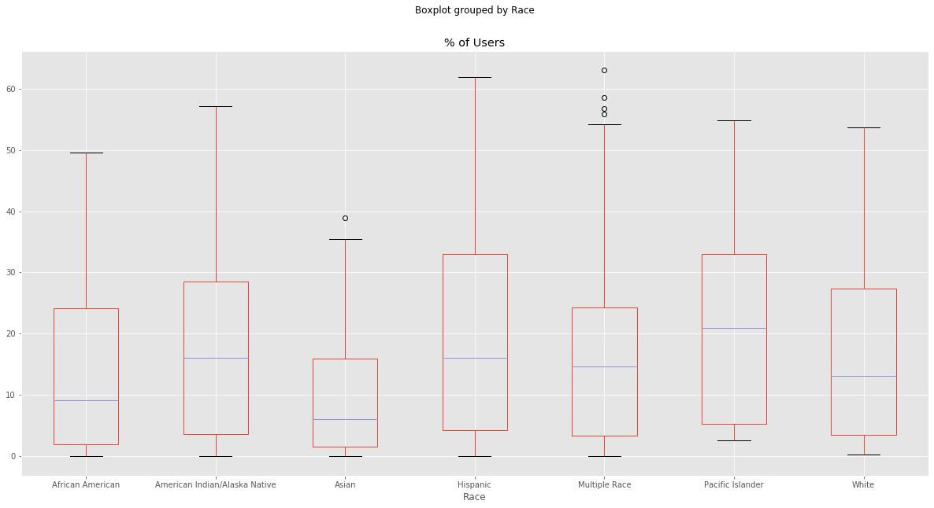
Boxplot for Comparing Variance in Ethnicity
F_onewayResult(statistic=8.341396710514884, pvalue=7.123927431358914e-09)
Notes:
The box plot compares percentage of users between races excluding the value for “All Races” for both years. The P- value here is 7.12, e-09. This value means, 7.12 X 10 ^-09.

Slide 11
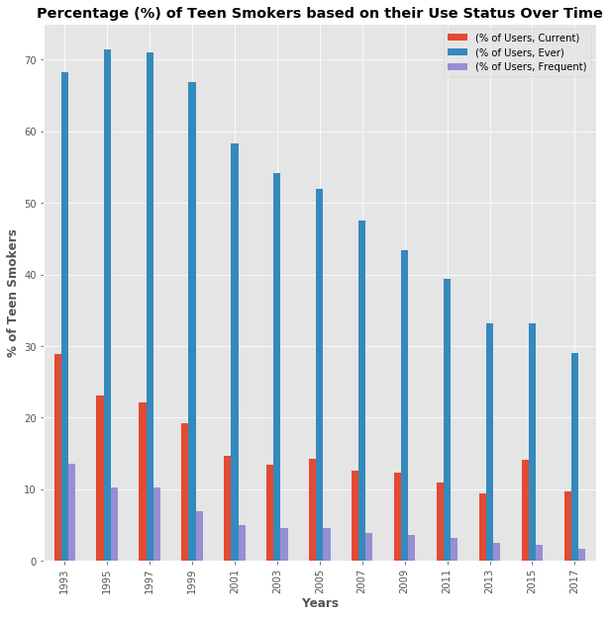
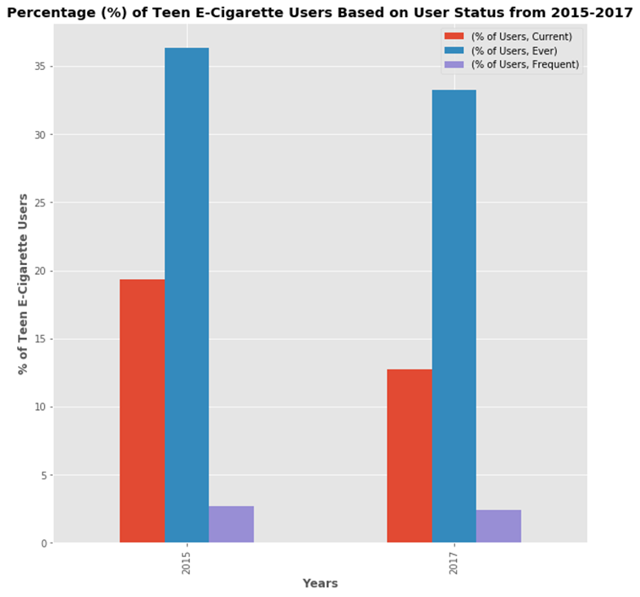
User Status: Frequency of Use Status
Notes:
The frequency of a users status also was tracked in the survey and contained the values of Ever used, Frequent Use and Current use. We wanted to see if there was a shift in users of e-cigarettes use patterns versus all types of tobacco usage. We did not complete any additional testing on these values, however, the overall graph pattern demonstrated a similar pattern as seen previously, with an overall trend downward, an apparent increase in 2015 and a return to decline in 2017.

Slide 12
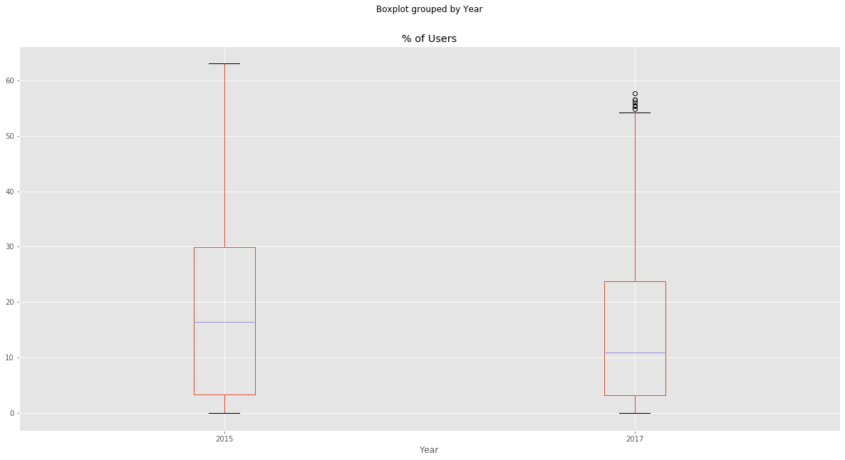
Boxplot of Percentage of Users Grouped by Year
statistic=19.592862428443475, pvalue=1.0085446000656468e-05
Notes:
The box plot of all users grouped by the two years of e-cigarette usage shows a Pvalue of 1.00 e-05.

Slide 13
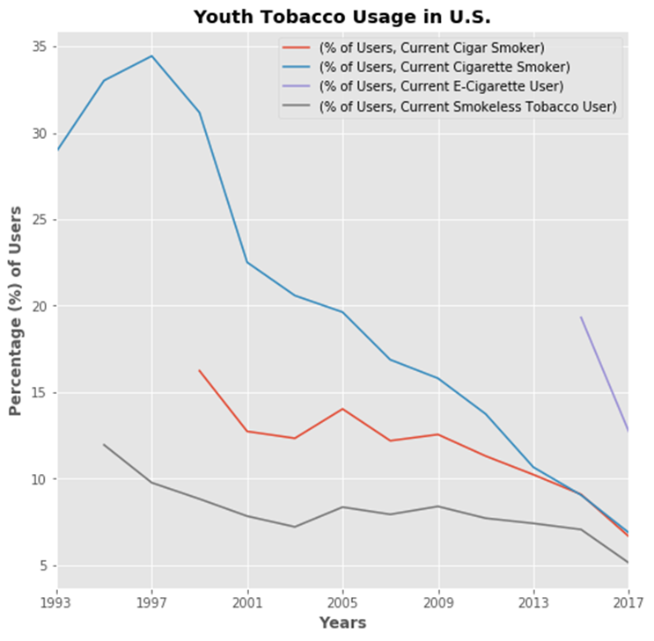
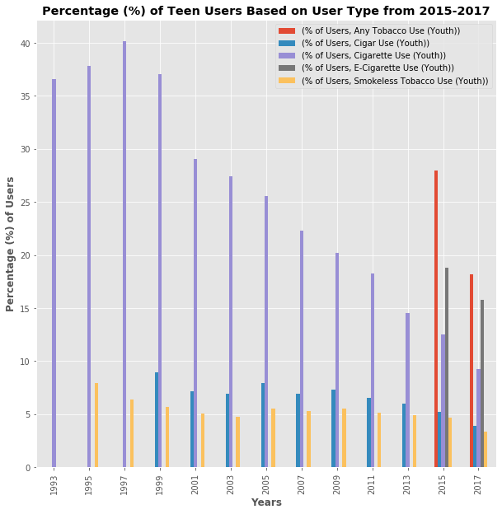
USAGE TYPE: Break Out by Type of Use
Notes:
We also wondered if the usage type impacted the value of the trend lines we were seeing in our earlier graphing measures, so we created a bar and a line graph of similar values to see what story they would tell. These proved interesting in that they demonstrated the difficulty in creating statistical meaning from data when the variables shift and change. The survey starts with only Cigarette use, then adds Cigar and smokeless tobacco and finally e-cigarette usage.

Slide 14
CDC: A Different Youth Survey
Tobacco Use* Among High School Students in 2018
Tobacco Product | Overall | Girls | Boys
Any tobacco product† | 27.1% | 24.9% | 29.1%
Electronic cigarettes | 20.8% | 18.8% | 22.6%
Cigarettes | 8.1% | 7.3% | 8.8%
Cigars | 7.6% | 6.0% | 9.0%
Smokeless tobacco | 5.9% | 3.3% | 8.4%
Hookahs | 4.1% | 4.1% | 4.0%
Pipe tobacco | 1.1% | 0.8% | 1.4%
Notes:
This data comes from the NYTS or National Youth Tobacco Survey – However this data was available only in a raw excel or SAS counts with the corresponding code book to the survey questions. This meant this data could not be used in the time frame of our project. However, we wanted to show this graph as it was a part of the original Surgeon Generals report, that the stats from the TED talk were taken from. Our survey did not have 2018 data available, however, if you take our 2017 for E-cigarette use of 15% to the 20.8% in one year, it becomes clearer the reason for alarm.

Slide 15
Conclusion: Trending Downward
Our dataset shows a statistically significant trend downward in all areas of tobacco use in teens
Our data shows a statistically significant impact on usage from 1993 – 2017
The data show a statistically significant impact on usage on all individual usage categories (Cigar, Cigarette, Smokeless Tobacco, & E-cigarettes) from 2015 - 2017
We could not find the 900% increase in nicotine use mentioned in the TED Talk across any of the usage categories
We would like to see the 2019 data to determine if we can find reported epidemic rise in nicotine usage
Notes:
Our conclusions for all measures and values demonstrated a clear downward trend line with a small increase in 2015, in which the tracking of e-cigarettes began for our data. We could not find statistical proof of the 900% increase mentioned in the TED talk from our data. However, we do believe that if we repeated this study when the 2019 data is released for this survey, the conclusion would most likely change. It would also be of value, to pull other survey’s from the CDC as well as other health data sources, to compare all the values and track the impact of the introduction of e-cigarettes on the health of teens now as well as the impact of these same individuals as they age.
And one additional point; when presented with a project with limited time and more resources than can be supported, it is more valuable to just pick a reliable source and see what you find than to keep shifting sources and not be able to draw any conclusions.

